Slide 1
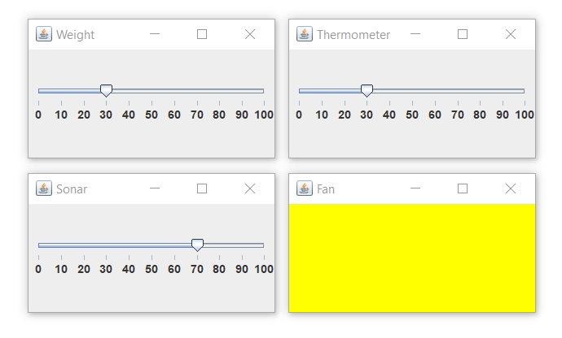
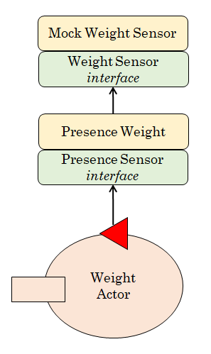
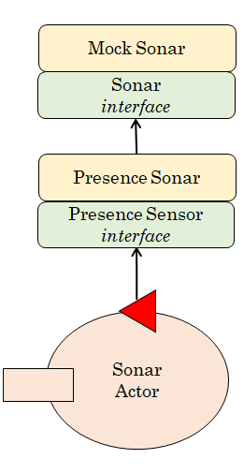
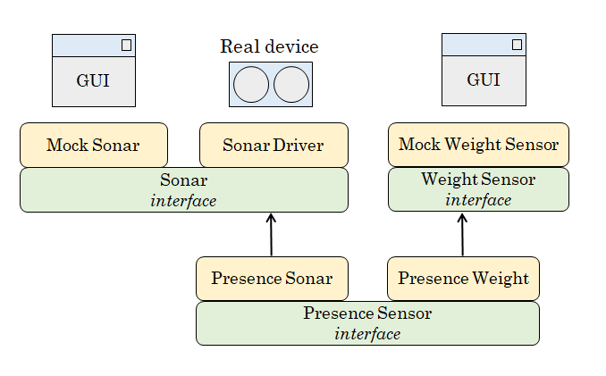
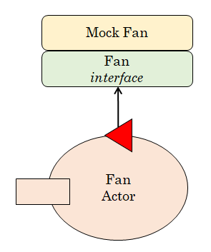
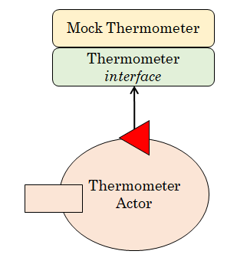
The Mock-Objects

Slide 2
The Directional Planner
Planner Util
locationsKb.pl
home(0, 0, s).
indoor(6, 0, n).
outdoor(6, 4, s).
parking1(1, 1, e).
parking2(1, 2, e).
parking3(1, 3, e).
parking4(4, 1, w).
parking5(4, 2, w).
parking6(4, 3, w).
Directional Planner
step( 335 )
Park Manager Service
(business logic)
goto( PLACE )
Trolley
Actor
Basic
Robot
movementDone
cmd( l )
cmd( r )

Slide 3
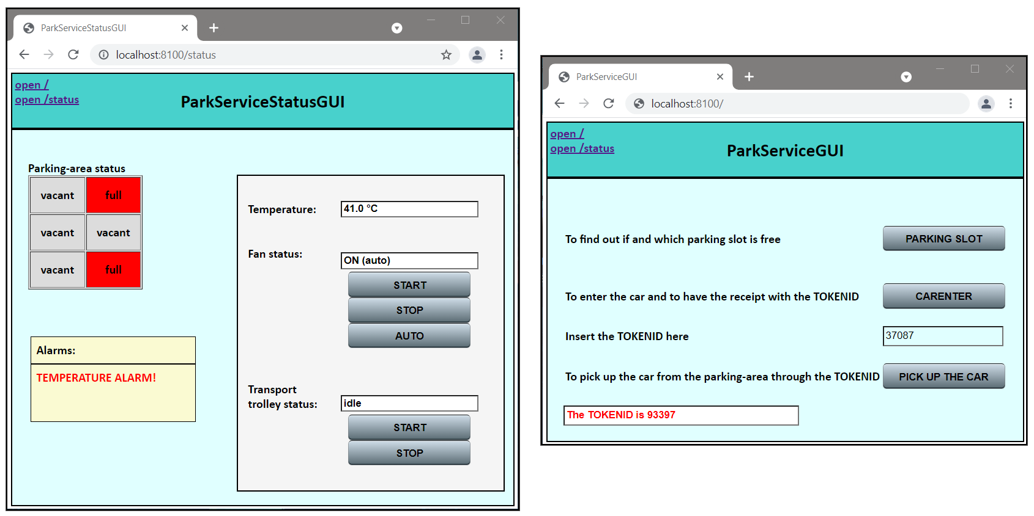
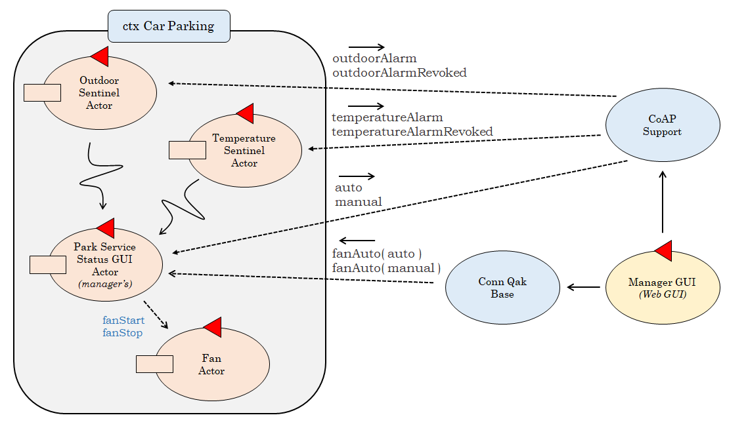
The Web GUIs

Slide 4
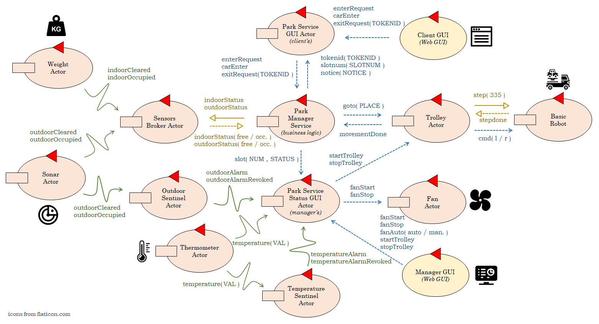
The Logical Architecture

